Slide 1
MELIGNANT-COMMENTS CLASSIFIER

Slide 2
ACKNOWLEDGMENT
I take great pleasure to thank and acknowledgement the allowance by Data Trained Education and permission by Flip Robo. I extend whole hearted thanks to them I worked and learned a lot and sharing me the knowledge and experience.
Data Trained Education and Flip Robo provided training is the very important to completion of project.

Slide 3
INTRODUCTION
Business Problem Framing
The proliferation of social media enables people to express their opinions widely online. However, at the same time, this has resulted in the emergence of conflict and hate, making online environments uninviting for users. Although researchers have found that hate is a problem across multiple platforms, there is a lack of models for online hate detection.
Conceptual Background of the Domain Problem
Online hate, described as abusive language, aggression, cyberbullying, hatefulness and many others has been identified as a major threat on online social media platforms. Social media platforms are the most prominent grounds for such toxic behaviour.
There has been a remarkable increase in the cases of cyberbullying and trolls on various social media platforms. Many celebrities and influences are facing backlashes from people and have to come across hateful and offensive comments. This can take a toll on anyone and affect them mentally leading to depression, mental illness, self-hatred and suicidal thoughts.
Review of Literature
Internet comments are bastions of hatred and vitriol. While online anonymity has provided a new outlet for aggression and hate speech, machine learning can be used to fight it. The problem we sought to solve was the tagging of internet comments that are aggressive towards other users. This means that insults to third parties such as celebrities will be tagged as unoffensive, but “u are an idiot” is clearly offensive.
Motivation for the Problem Undertaken
Our goal is to build a prototype of online hate and abuse comment classifier which can used to classify hate and offensive comments so that it can be controlled and restricted from spreading hatred and cyberbullying.

Slide 4
Analytical Problem Framing
Mathematical/ Analytical Modeling of the Problem
This dataset contains information about Malignant comments classifier listed on train dataset. This data can be used for a lot of purposes such as Malignant prediction to exemplify the use of Random Forest regression in Machine Learning.
Data Sources and their formats
The columns in the given dataset is as follows:..
The data set contains the training set, which has approximately 1,59,000 samples and the test set which contains nearly 1,53,000 samples. All the data samples contain 8 fields which includes ‘Id’, ‘Comments’, ‘Malignant’, ‘Highly malignant’, ‘Rude’, ‘Threat’, ‘Abuse’ and ‘Loathe’.

Slide 5
Analytical Problem Framing
The data set includes:
Malignant: It is the Label column, which includes values 0 and 1, denoting if the comment is malignant or not.
Highly Malignant: It denotes comments that are highly malignant and hurtful.
Rude: It denotes comments that are very rude and offensive.
Threat: It contains indication of the comments that are giving any threat to someone.
Abuse: It is for comments that are abusive in nature.
Loathe: It describes the comments which are hateful and loathing in nature.
ID: It includes unique Ids associated with each comment text given.
Comment text: This column contains the comments extracted from various social media platforms

Slide 6
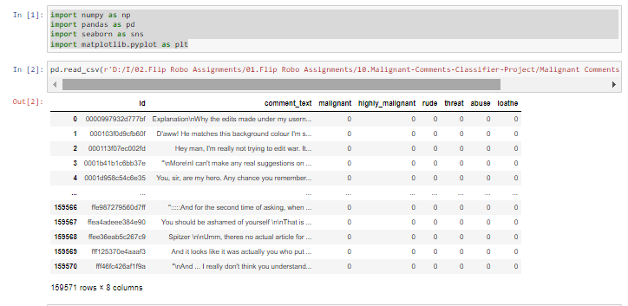
Data Sources & Formats
Collected dataset using scrapping the data as below:

Slide 7
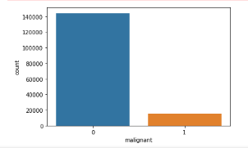
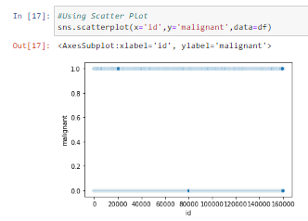
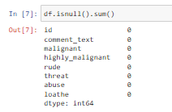
EDA steps and visualizations
After null values and encoding the data moving to the EDA steps and visualization.
In visualization it visualize the data in easy format.
In visualization, comparing the feature and target value in a plot.
For plotting the data in this project used Count plot & scatter plot.

Slide 8
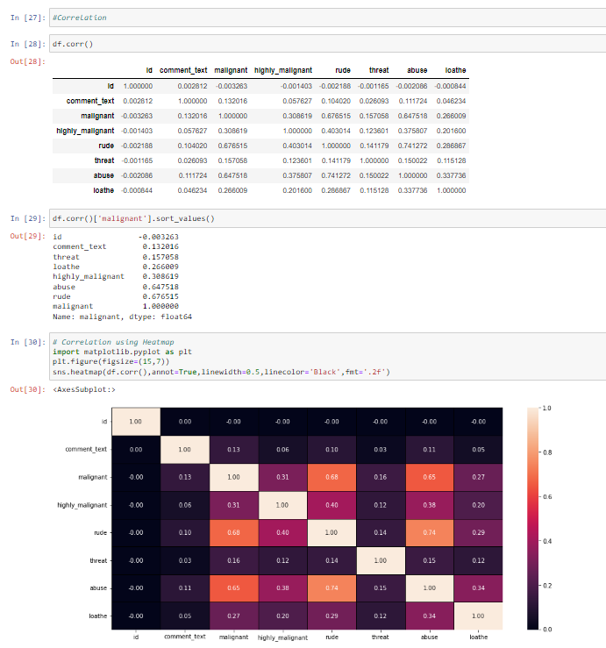
Steps
After visualizing the data checking correlation between the feature and target variable data.
In this some of the variables are highly correlated target variable.
For correlation checking using heatmap correlation method
comment_text and malignant features are highly correlated with each other.
highly_malignant and malignant features are highly correlated with each other.
threat and malignant columns features are highly correlated with each other.
loathe and malignant is also highly correlated with Price column.
abuse and malignant is highly correlated with each other
rude and malignant is highly correlated with each other

Slide 9
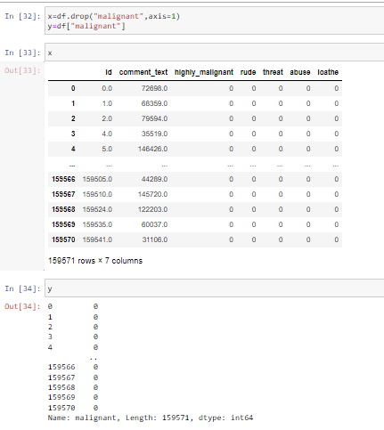
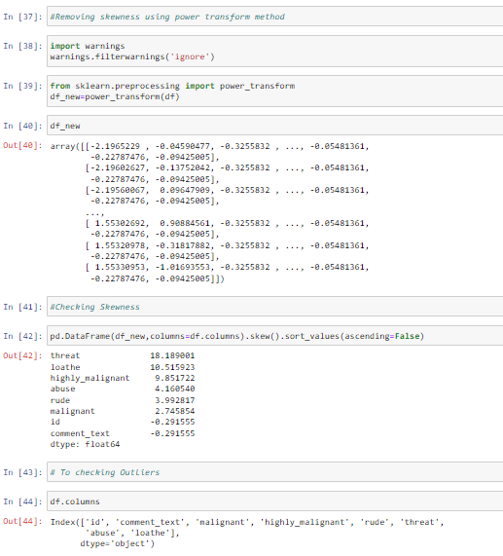
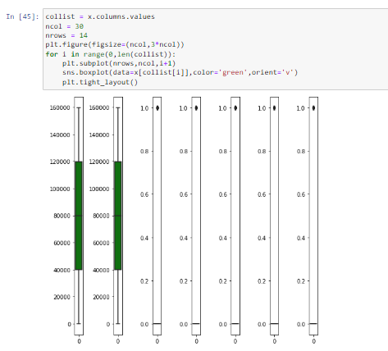
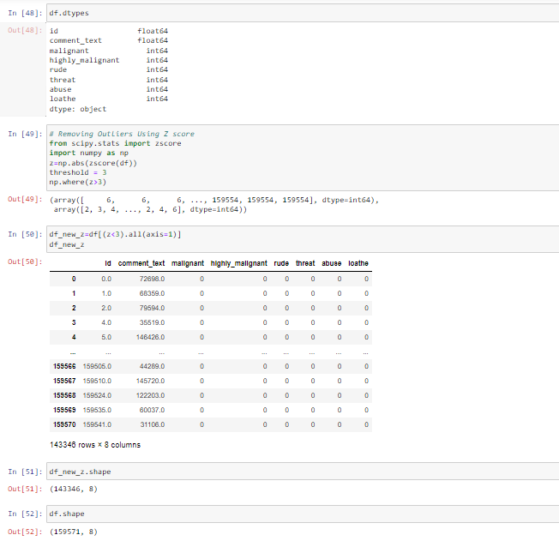
Steps
Checking skewness & outliers for given data.

Slide 10
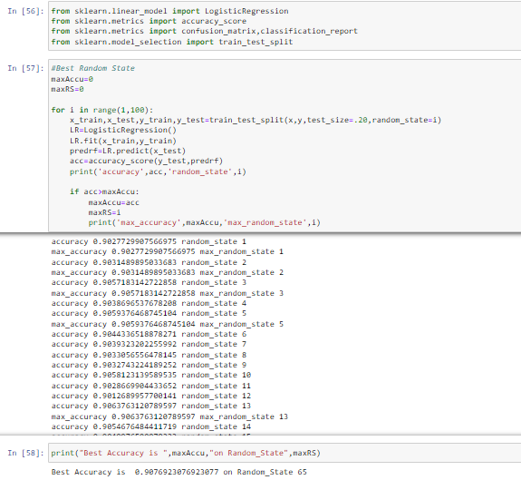
Scaling the model
For Training & Testing data using LogisticRegression model.

Slide 11
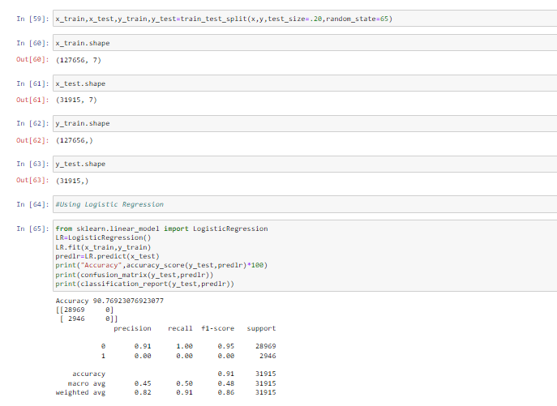
Building the Model
After Scaling the data need to build a model.
For model building using DecisionTreeClassifier, RandomForestClassifier, SVC, ExtraTreesClassifier , KNeighborsClassifier, XGBClassifier , AdaBoostClassifier.
In this used RandomForestClassifier method to build the model.
After that splitting the dataframe using Train test split method.
In train test split method finding the trained data & testing data and also finding predicted data.

Slide 12
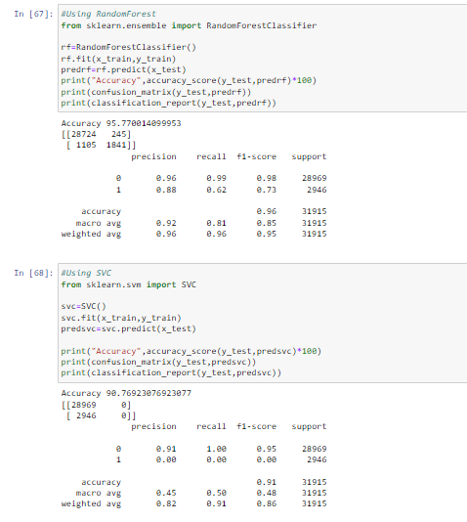
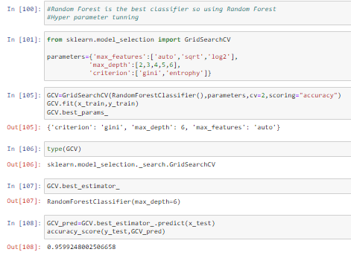
Model Selection
For this project RandomForestClassifier best method to built the model.
We have achieved approximately 95% using RandomForestClassifier Hyperparameter tuning.

Slide 13
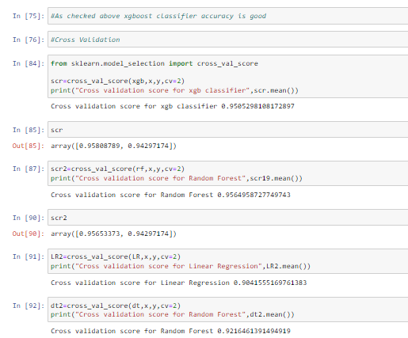
Cross Validation & gridSearchCV
Using cross validation method checking model performance.
After cross validation need to find the best classifier.
For findout best classifier using RandomizedSerachCV method
Using RandomizedSearchCV to find out best_params_ value
After that need to find out best estimator
Best estimator value is “RandomForestClassifier” Accuracy Score.

Slide 14
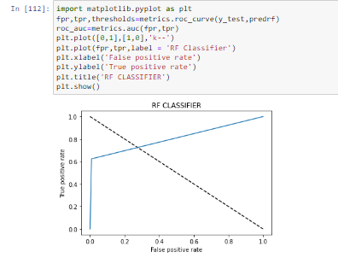
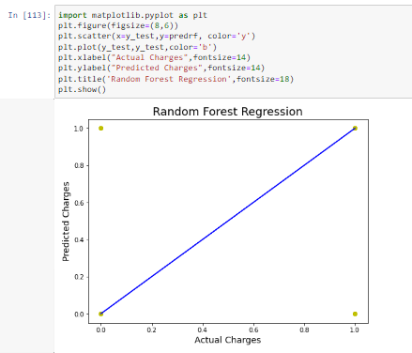
AUC ROC Curve
After completing the steps and process draw the AUC ROC curve.
In AUC ROC Curve its showing the False Positive Rate & True Positive Rate.
Below drawing AUC ROC Curve for False Positive Rate & True Positive Rate using RandomForestClassifier method.

Slide 15
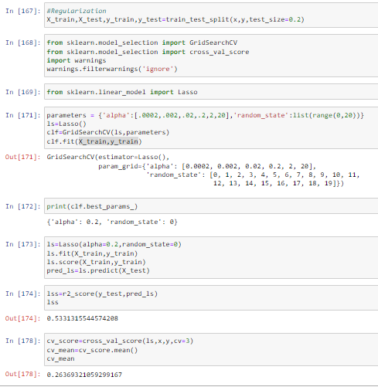
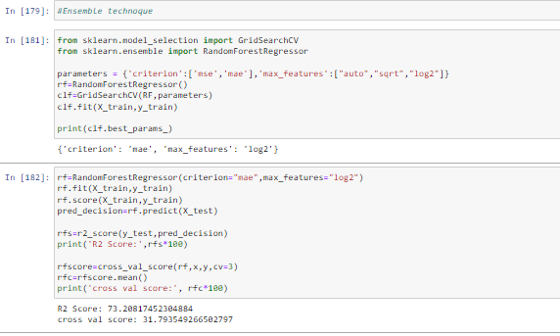
Interpretation of the Results
After Building a model need to Regularization technique for model checking.
After Regularization a model need to Ensemble technique for model checking

Slide 16

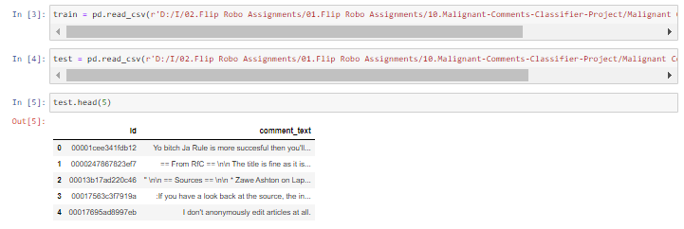
Model Building for Test Data:-
Importing the Libraries:
Loading the Dataset:

Slide 17
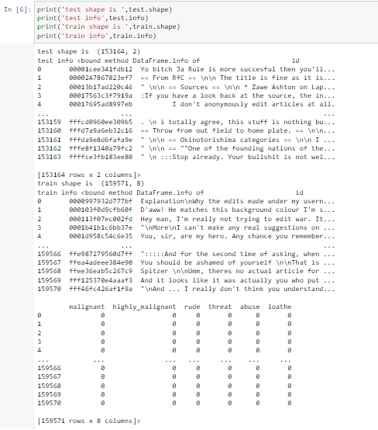
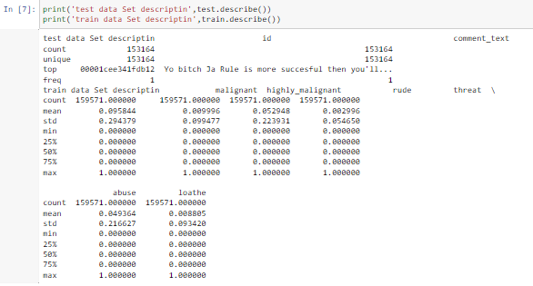
Model Building for Test Data:-
After that we are checking shape of values & describing the data:

Slide 18
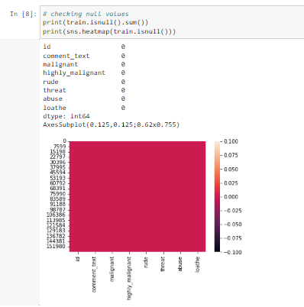
Model Building for Test Data:-
After that we are checking if Null values are present in datasets.

Slide 19
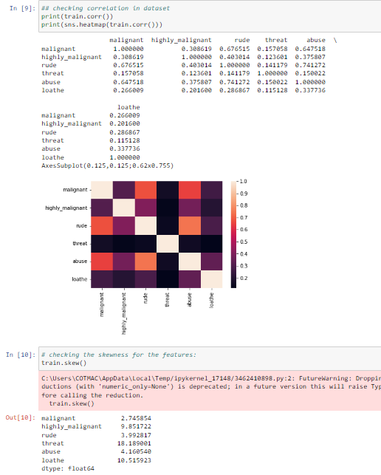
Model/s Development and Evaluation
Identification of possible problem-solving approaches (methods)
Checking correlation & skewness of the data:

Slide 20
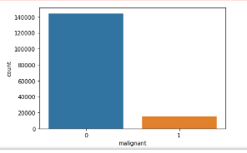
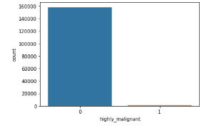
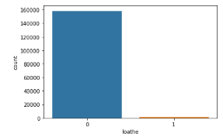
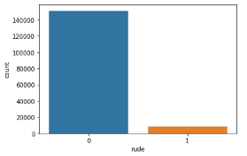
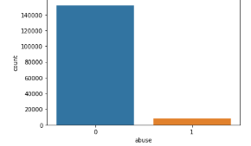
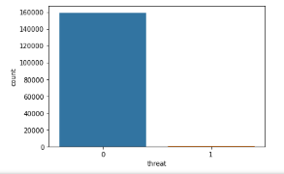
Model/s Development and Evaluation
After that Checking EDA Part:

Slide 21
Methodology
Data Preprocessing
The following steps were taken to process the data:
→ A string without all punctuations to be prepared:
1. The string library contains punctuation characters. This is imported and all numbers are appended to this string. Our comment_text field contains strings such as won't, didn't, etc. which contain apostrophe character('). To prevent these words from being converted to wont or didn't, the character ' represented as \' in escape sequence notation is replaced by empty character in the punctuation string.
→ Updating the list of stop words:
1. Stop words are those words that are frequently used in both written and verbal communication and thereby do not have either a positive or negative impact on our statement like “is, this, us, etc.”.
2. Single letter words if existing or created due to any preprocessing step do not convey any useful meaning and so they can be directly removed. Hence letters from b to z, will be added to the list of stop words imported directly.
→ Stemming and Lemmatizing:
1. The process of converting inflected/derived words to their word stem or the root form is called stemming. Many similar origin words are converted to the same word e.g. words like "stems", "stemmer", "stemming", "stemmed" as based on "stem".
2. Lemmatizing is the process of grouping together the inflected forms of a word so they can be analyzed as a single item. This is quite similar to stemming in its working but differs since it depends on correctly identifying the intended part of speech and meaning of a word in a sentence, as well as within the larger context surrounding that sentence, such as neighboring sentences or even an entire document.
3. The wordnet library in nltk will be used for this purpose. Stemmer and Lemmatizer are also imported from nltk.

Slide 22
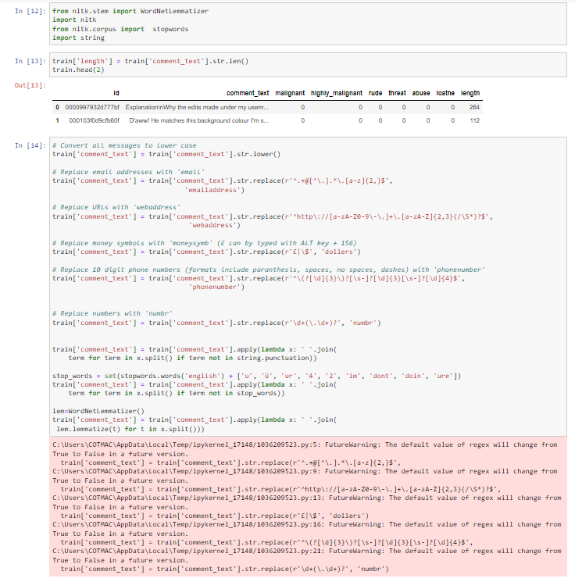
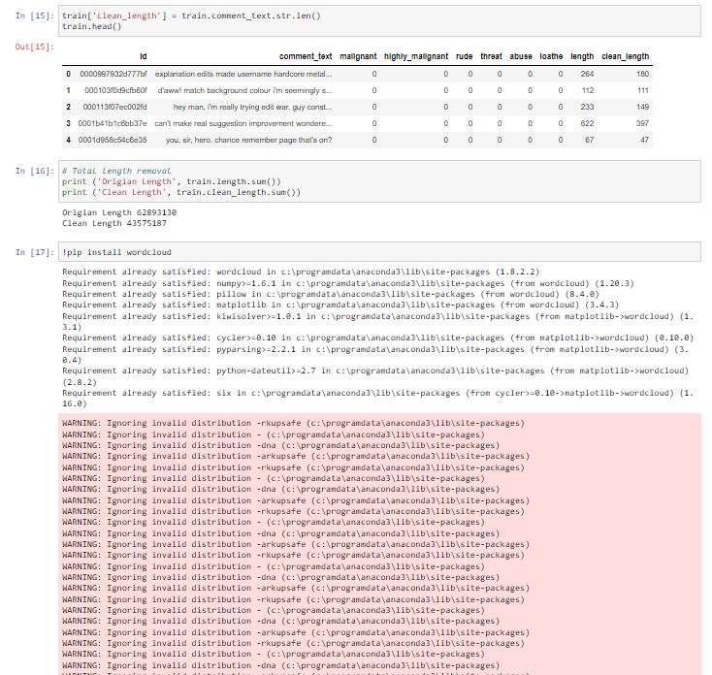
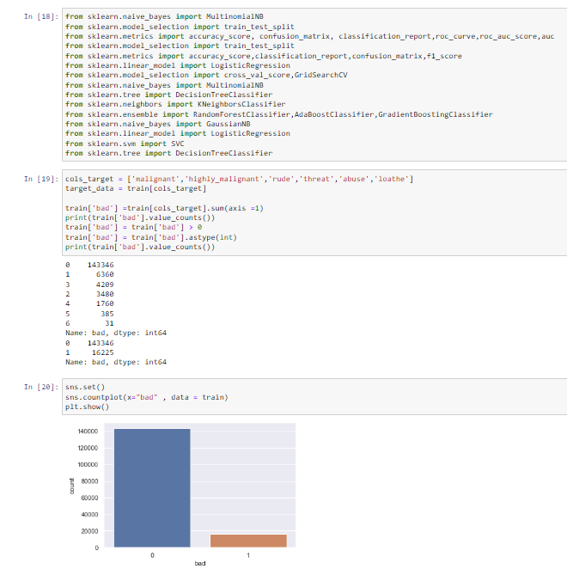
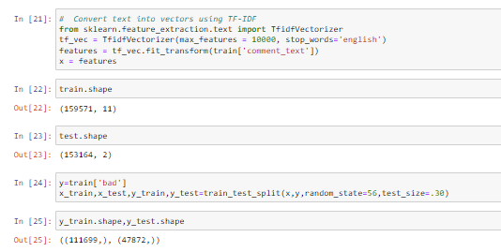
Removing Punctuations, stopwords,WordNetLemmatizer
We have performed the following preprocessing on the data:
Removed punctuations
Removed the stop words
Stemming and lemmatization
Applied counter vectorizer

Slide 23
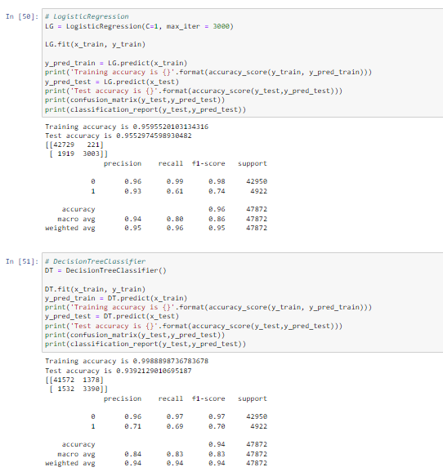
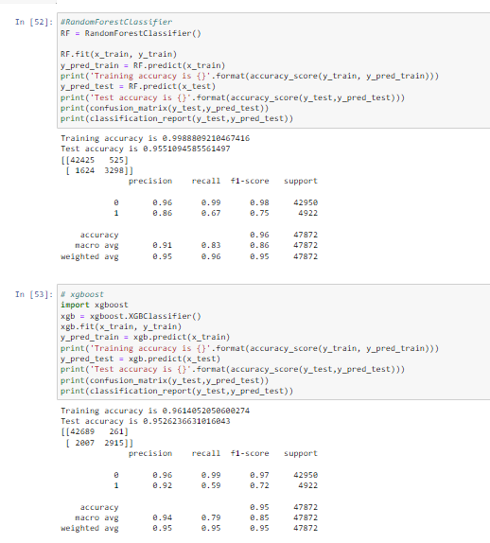
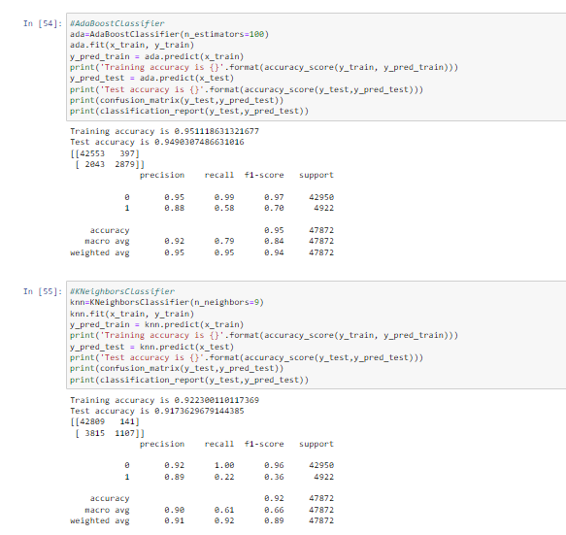
Splitting dataset into Training and Testing
1. Since the system was going out of memory using train_test_split, I had jumbled all the indexes in the beginning itself.
2. The shuffle function defined here performs the task of assigning first 2/3rd values to train and remaining 1/3rd values to the test set
As below checked algorithm Random Forest Classifier accuracy is good

Slide 24
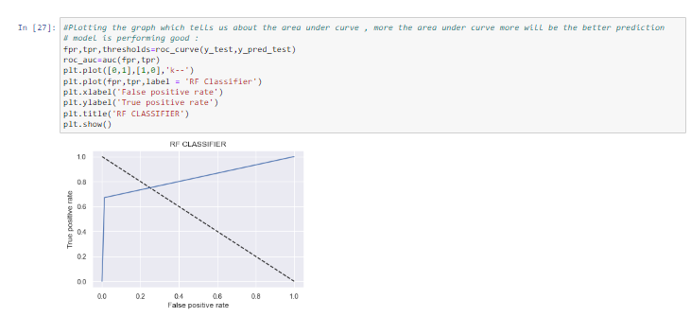
Visualizations
AUC ROC Plot:

Slide 25
Conclusion
Key Findings and Conclusions of the Study
Using different models for Malignant Comments Classifier prediction. Seven different types of Machine Learning methods including DecisionTreeClassifier, RandomForestClassifier, SVC, ExtraTreesClassifier , KNeighborsClassifier, XGBClassifier , AdaBoostClassifier are compared and analyzed for optimal solutions. Even though all of those methods achieved desirable results, different models have their own pros and cons. The Random Forest method has the lowest error on the training set but is prone to be overfitting. So using RandomForestClassifier method draw the AUC ROC Curve.
Learning Outcomes of the Study in respect of Data Science
As we checked in dataset not present null values.
Visualizing the categorical data using countplot.
Converted Categorical data into numerical data using Encoder method.

Slide 26
Conclusion
As checked dataset we used Classification method due classification data & more independent columns are related to depedent column.
After we applied Regression methods like DecisionTreeClassifier, RandomForestClassifier, SVC, ExtraTreesClassifier , KNeighborsClassifier, XGBClassifier , AdaBoostClassifier.
After checked Cross validation train & test accuracy is good for RandomForestClassifier method.

Slide 27
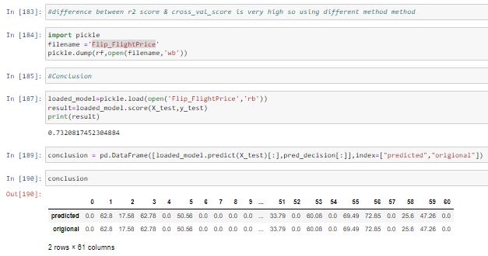
Conclusion
Limitations of this work and Scope for Future Work
The used pre-processing methods do help in the prediction accuracy. However, experimenting with different combination of pre-processing methods to achieve better prediction accuracy.
Make available features in combining the features and predict it may be improved performance.

